Slide 1


STUDENT PERFORMANCE PREDICTION USING LINEAR REGRESSION
OUR TEAM: Guna Vardhan Byraju[AP23110010744]
Jesweer Kalakonda[AP23110010054]
Sai Sumanth Oruganti[AP23110010786]

Slide 2
Introduction
Introduction
Dataset Overview
This project predicts the final grade (G3) of students.
Total rows: 1000
Uses academic, behavioral, and family-related attributes.
Total columns: 33
Implemented Linear Regression using both:
Dataset: Portuguese Student Performance Dataset
Custom Gradient Descent
Target variable: G3 (Final Grade)
Sklearn Regression

Slide 3
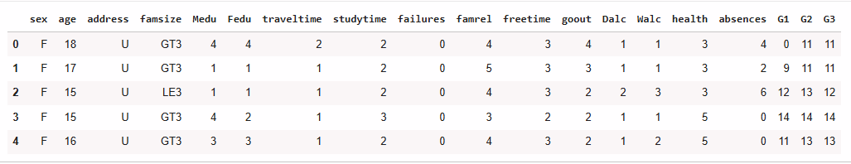
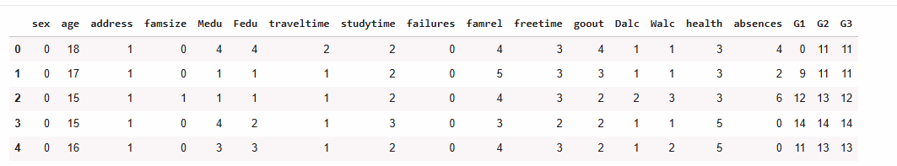
DATA PREPROCESSING
Preprocessing Steps
Removed irrelevant or repeated columns
Handled categorical values using Label Encoding
Created df_clean containing selected columns
Converted dataset into a fully numeric form (df_encoded)
Final dataset used: 19 numeric features
Before Encoding After Encoding

Slide 4
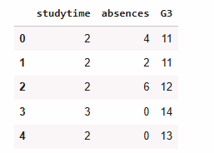
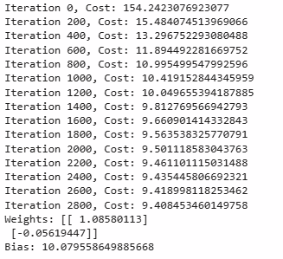
MODEL 1: SIMPLE REGRESSION
Features Used
Result
Studytime
MSE: 9.93 (High)
Absences
MAE: 2.26 (High) ❌ Too simple → low accuracy ❌ Important predictors missing

Slide 5
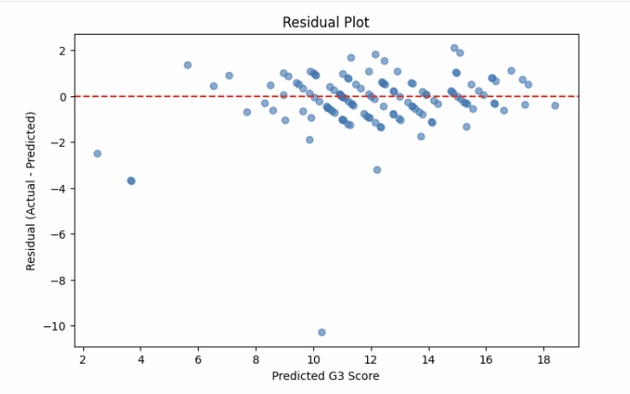
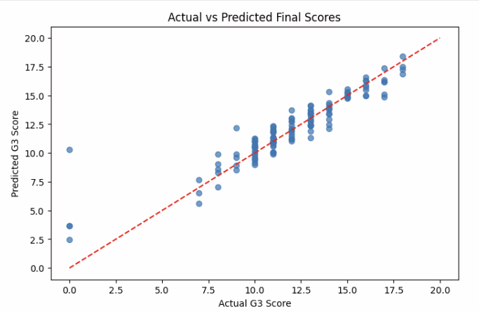
MODEL 2: GRADIENT DESCENT REGRESSION
Approach
Results
Implemented custom gradient descent from scratch
MSE: 1.72
MAE: 0.78
Initialized weights & bias manually
Updated parameters using:
Cost function
Partial derivatives
Learning rate

Slide 6
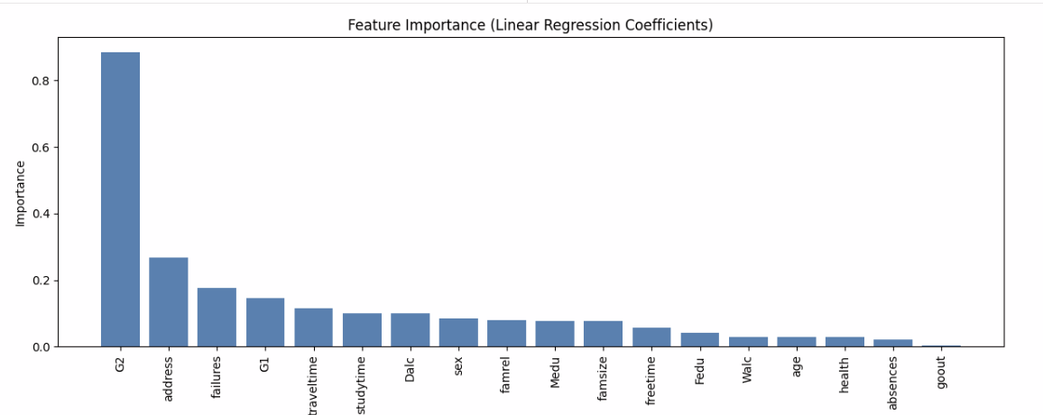

FEATURE IMPORTANCE (FULL MODEL)
Top Features
Conclusion
G2 — Most important
Many features add noise → accuracy decreases
G1
Failures
Studytime
Strong features should be selected
Traveltime
Absences

Slide 7
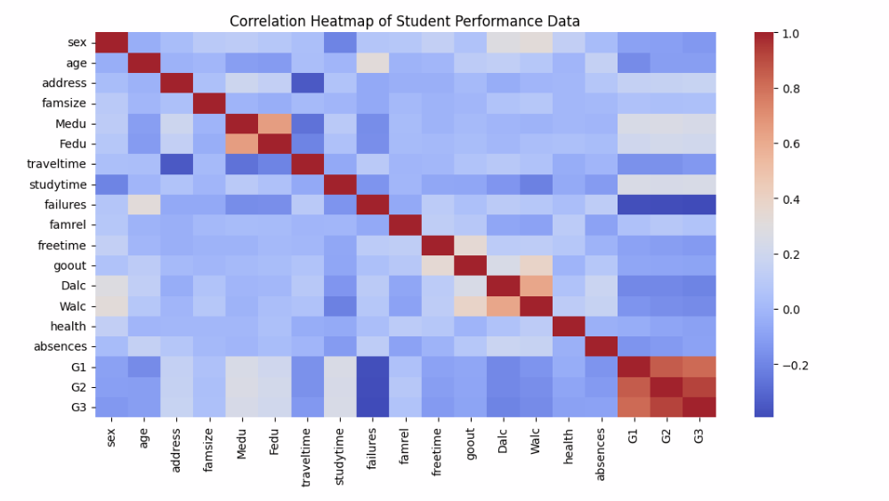
CORRELATION ANALYSIS
Heatmap Insights
G2 (2nd Period Grade) has the strongest correlation with G3
G1 is also highly correlated
Failures, Absences, Traveltime negatively impact G3
Studytime slightly improves performance
Alcohol consumption (Walc, Dalc) reduces performance

Slide 8
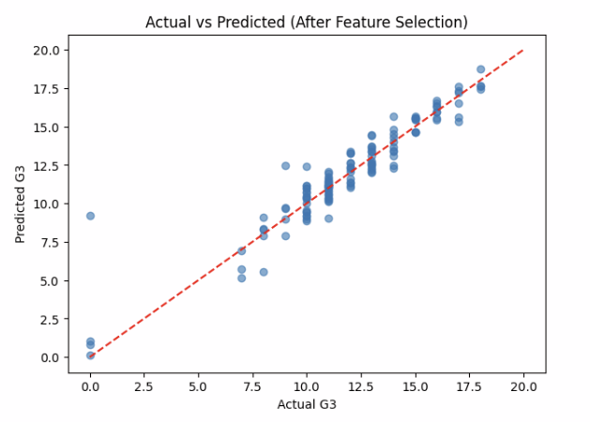
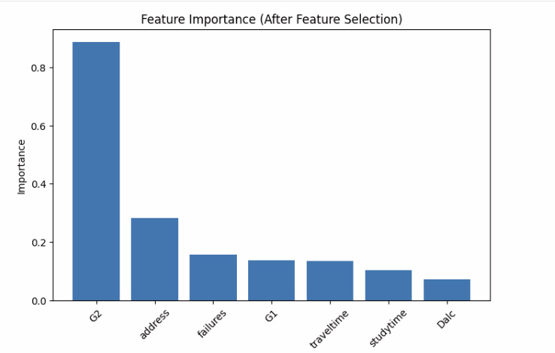
MODEL 3: STRONG FEATURES REGRESSION
Selected Strong Features
Performance
Based on heatmap + importance graph:
MSE: 1.37
G2
MAE: 0.73 ➡ Best-performing model
G1
Studytime
Failures
Traveltime
Absences
Dalc

Slide 9
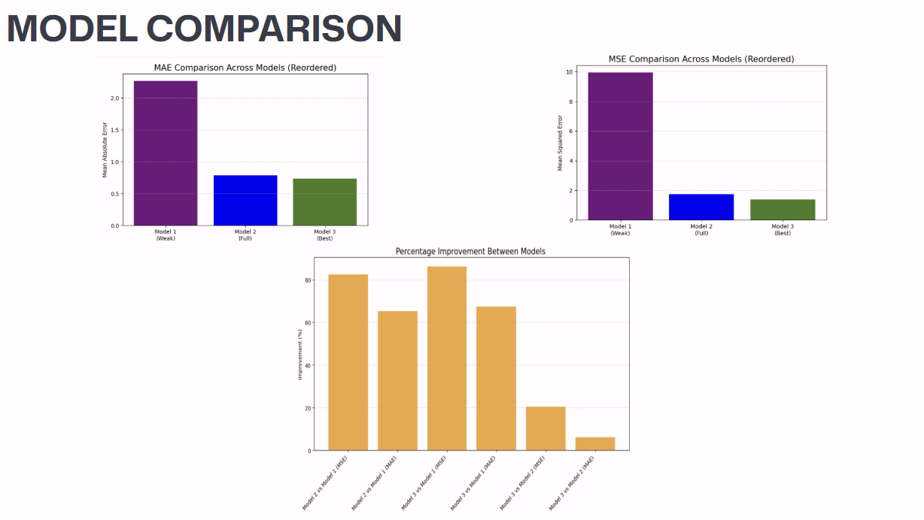
MODEL 3: STRONG FEATURES REGRESSION
Selected Strong Features
Performance
Based on heatmap + importance graph:
MSE: 1.37
G2
MAE: 0.73 ➡ Best-performing model
G1
Studytime
Failures
Traveltime
Absences
Dalc

Slide 10
MODEL COMPARISON
Final Performance Summary
Model
Features
MSE
MAE
Result
Model 1
2
9.93
2.26
Bad
Model 2
12
1.72
0.78
Good
Model 3
7
⭐1.37
⭐0.73
BEST
🏆 Final Winner:
MODEL 3 — Strong Feature Regression

Slide 11
CONCLUSION & FUTURE WORK
Conclusion
Future Enhancements
Strong feature selection greatly improved accuracy
Try Random Forest, XGBoost
G2 and G1 are the strongest predictors
Add Polynomial Regression
Gradient Descent and Sklearn gave similar trend
Deploy using Streamlit Web App
Model 3 is the best model for prediction
Hyperparameter tuning for more accuracy

